Slide 1
BRA Sports Goods
Joao Vitor Bonanoni
Lucas Pereira Silva
Kainan dos Santos
Grant Arnett

Slide 2
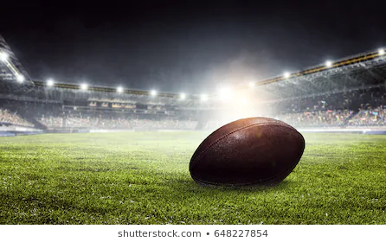
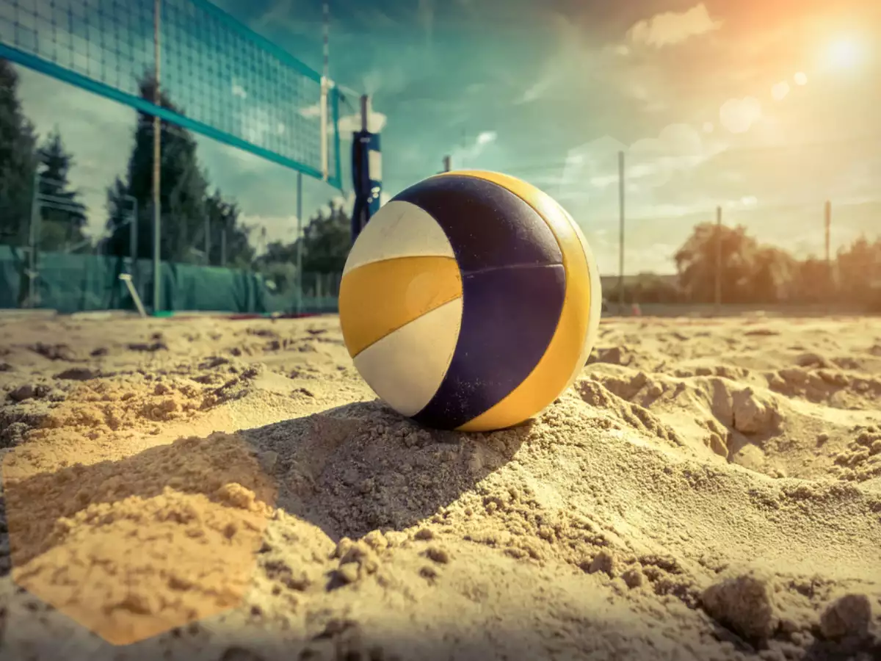

About our business
BRA Sports Goods offers the best quality of sportive goods, working with the 10 most famous brands of the market. One of the unique companies that provide high-level professional sportive goods.
By this, our company is able to offer the best quality of service inside the sports area.

Slide 3


Situation Analysis
Places
10 physical stores in the Missouri state
Online store
Competitors
Hibbett Sports
Dick’s Sporting Goods
Walmart

Slide 4
Strenghts
Weakness
Opportunities
Threats

Slide 5
Strenghts
Availability of first line products.
Good and quick interaction with the customers.
Good relationship between the employees in the workplace.
Coverage of more than 10 most famous sports brands around the country.
Fast delivery.

Slide 6
Weakness
Lack of availability in other states
Restrict reach to find employees outside the state (MO).
Bureaucracy on the delivery process.

Slide 7
Opportunities
Reach college athletes that live around our stores.
Promote our company through the colleges.
Growing to neighbor states
Promote events to support the practice of sports in schools.

Slide 8
Threats
Low prices in some of our competitors stores with low quality products. Selling a fake feeling of getting a good sportive product.
Complex delivery process by online sells.

Slide 9
Finances of BRA Sports Goods
Estimated starting cost: $50,000
Cash: $50,000
Accounts receivable: four joint accounts.
Inventory: $10,000
Property: $10,000
Equipment: $5,000
Salary of Employees: $10/hour
Other assets: The remaining money will go to the particular storefront and will be used to further the size of our merchandise.
Summary: $50,000 is a stable number that our business can be successful at and still be conservaive in our spending projects. This is a break down for each store front. Our plan with the business should be stable for the next 5 years following the same procedures as our first year.

Slide 10
Profit’s annually
Year One:
The Business should spend a total of $50,000 in its first year. This includes everything on our businesses financial statement.
Business Spendings: $50,000
Business Profit after one year: $48,000
The revenue gained from the first year of our business will be used to expand in our products. This will cause a major positive growth in revenue the following year.

Slide 11
Business Expectations
The business plans on keeping the same business outlook but expanding it revenues each year. The following information is the amount of revenue we should have each year.
2021:
$58,000 profit / selling 10,000 products.
2022:
$75,000 profit / selling 15,000 products.
2023:
$109,000 profit / selling 18,000 products
2024:
$147,000 profit / selling 20,000 products.

Slide 12
Marketing and Advertising
Social Media: Instagram, Facebook and Twitter.
Online store
Advertisement in the colleges around the stores
Flyers in college and sports events

Slide 13
Objectives for the next year
Profit
Increase the profit in 15% percent in the first semester of 2021..
Brand awareness
Grow the number of walk-in clients and the number of online visits.
Improve our delivery system
Have a faster and easier way to delivery online products

Slide 14
Future goals
Become the biggest sportive franchise in the midwest of USA
Become a sponsor of 5 big universities in USA
Expand our company worldwide with our online store

Slide 15
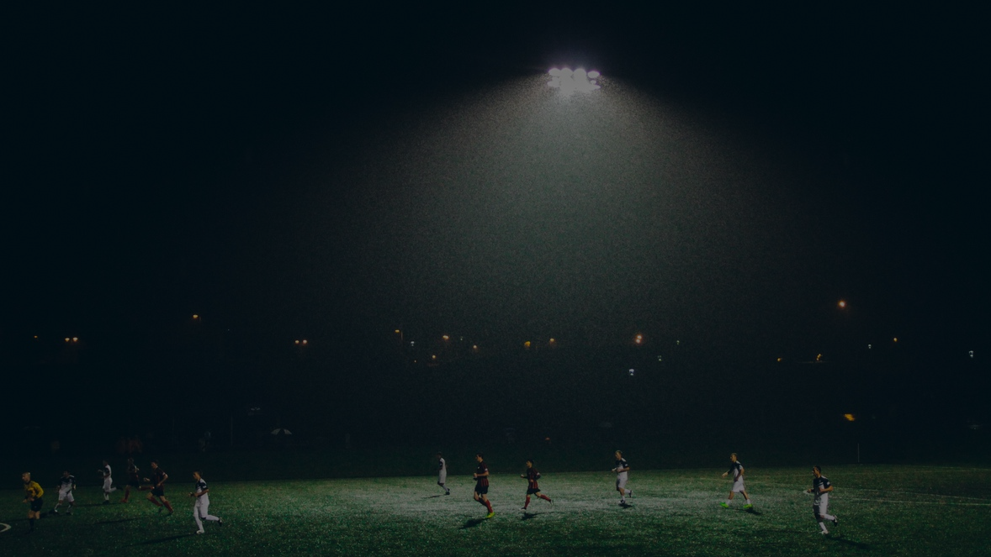
Thank you for your attention
We hope to receive you in our amazing store

